Slide 1
BIG O
Java
Mr. Neat

Slide 2
We want to be able to characterize
algorithm performance
Two Factors:
- how much memory required
- how fast

Slide 3
Want to be able to assess speed
independent of machine (platform).
We can do this by defining the “order” of an algorithm.
O in Big O stands for Order.

Slide 4
Let’s try some examples:
What is the order of this algorithm?
public void getFirstElement(List[ ])
{
return List[0];
}
O(1)

Slide 5
public int sumData(List[ ])
{
int total = 0;
for(int loop = 0; loop < loop.length(); loop++)
{
total = total +List[loop];
}
return total;
}
O(n)

Slide 6
public void bubble(List[ ])
{
for(int outer = 0; outer < List.length()-1; outer++)
{
for(int inner = 0; inner<List.length()-outer-1;inner++)
{
if(List[inner] >List[inner+1]
{
swap(List[inner],List[inner+1]);
}
}
}
}
O(n²)

Slide 7
Plots are nice!
n
n²
0
1
2
3
4
5
6
7
8
9
10
0
1
4
9
16
25
36
49
64
81
100

Slide 8
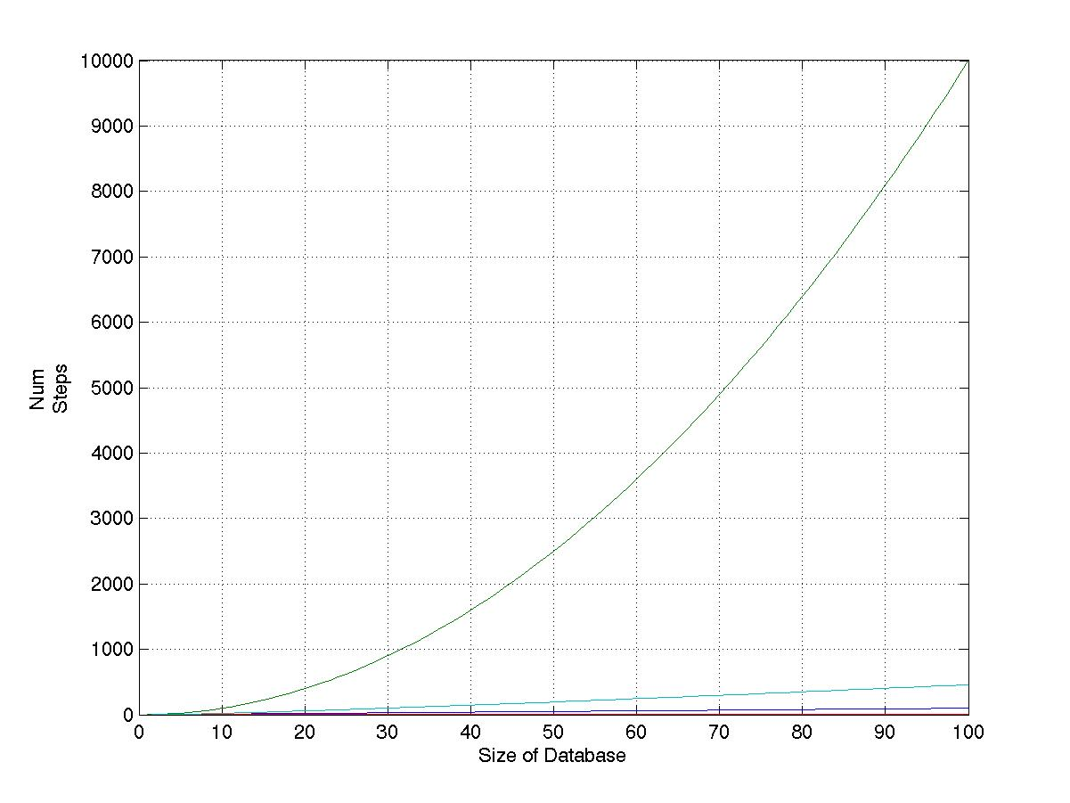
n²
n

Slide 9
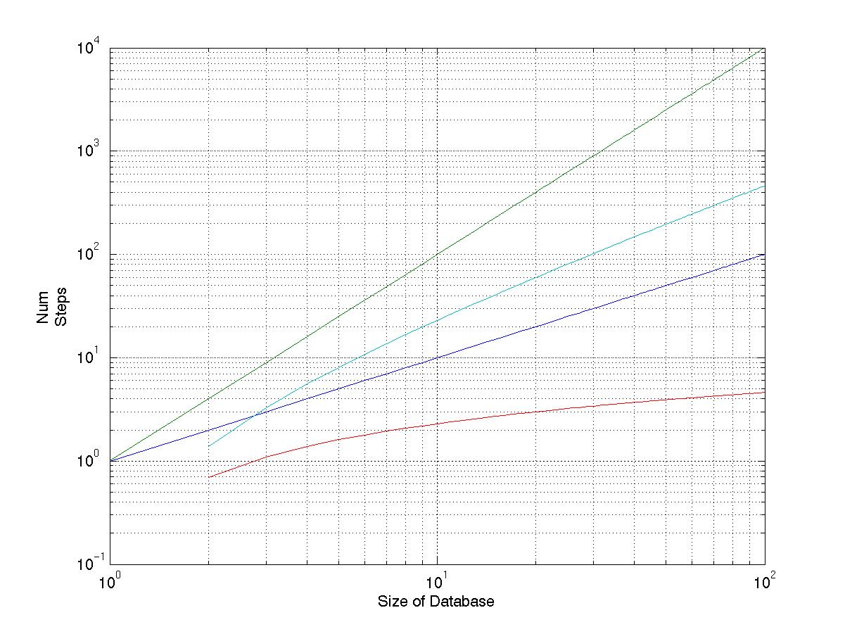
n²
n

Slide 10
Any Questions?

